Slide 1
Ecommerce Purchases
By- Vaishnavi Thiruvayarpadi
Shamanth H S
Hunagund Sharikh Mannusaheb
Rajath Hegde
Saurav R Baliga

Slide 2
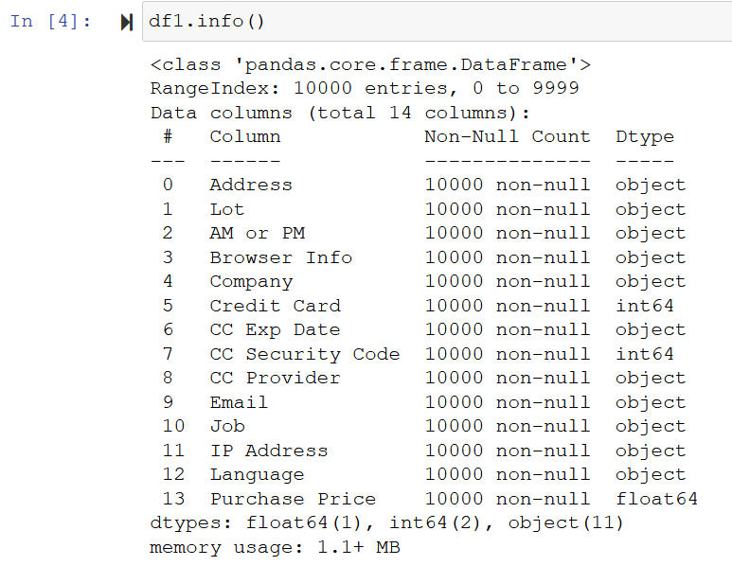
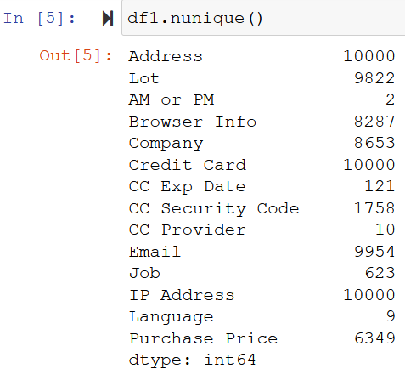
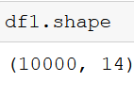
In this presentation, we are going to analyze the Ecommerce Purchases dataset by using data exploration, analysis, and visualizations methods available in python.
Initial Data Explorations
info() :- It prints a concise summary of the given DataFrame.
nunique() :- It returns the number of unique values in each column (NaN values not included).
shape :- It returns the dimensionality of the given DataFrame.
head() :- returns the first 5 rows of the given dataset.

Slide 3
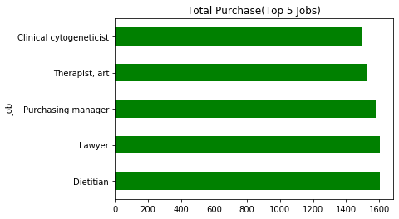
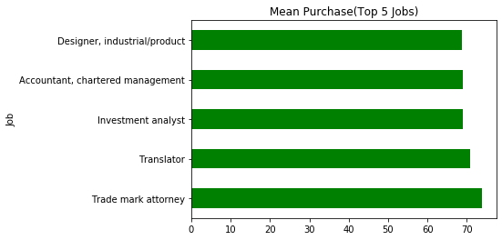
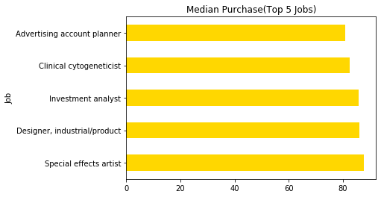
Statistical Analysis of the Top 5 Jobs with High Purchase Prices
Bar plot to show the total purchases done by the top 5 jobs
Bar plot to show the average purchases done by the top 5 jobs.
Bar plot to show the median purchases done by the top 5 jobs.

Slide 4
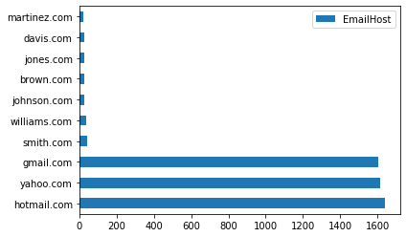
Popular EMAIL Providers/Hosts

Slide 5
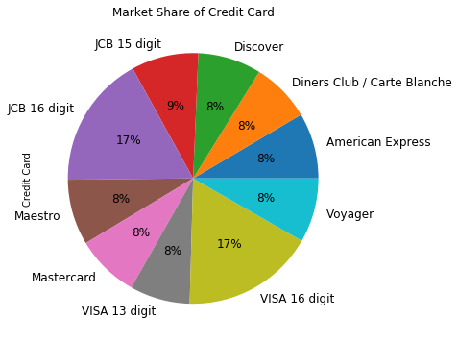
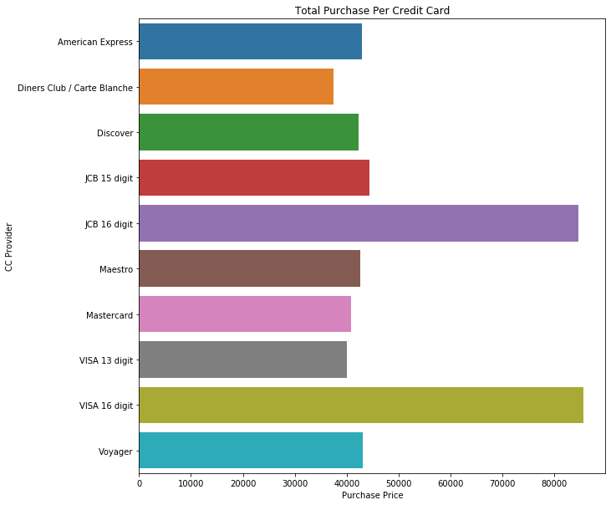
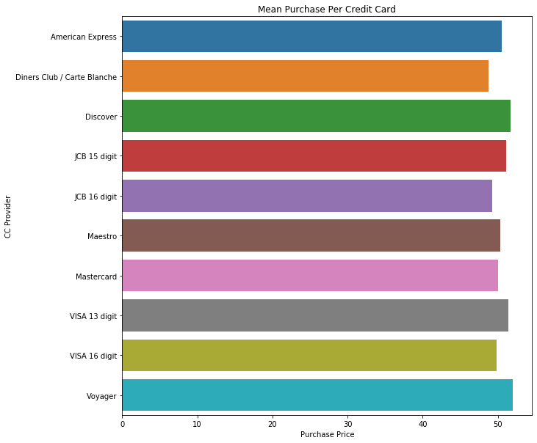
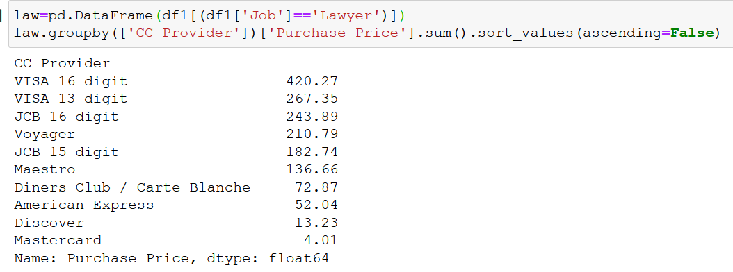
Analysis Based on Credit Card Spend
Pie Chart Depicting the total Market Share of each Credit Card
Bar plot to show the total purchases per credit card
Bar plot to show the mean purchase per credit card
Sum of Purchase Prices of lawyers with each CC Provider

Slide 6
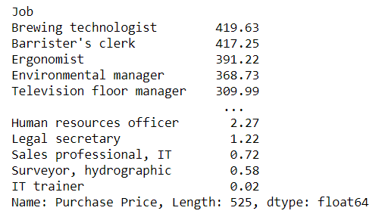
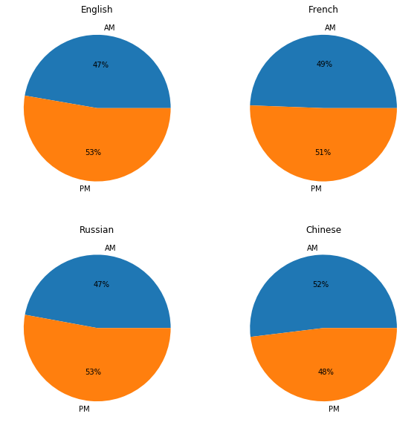
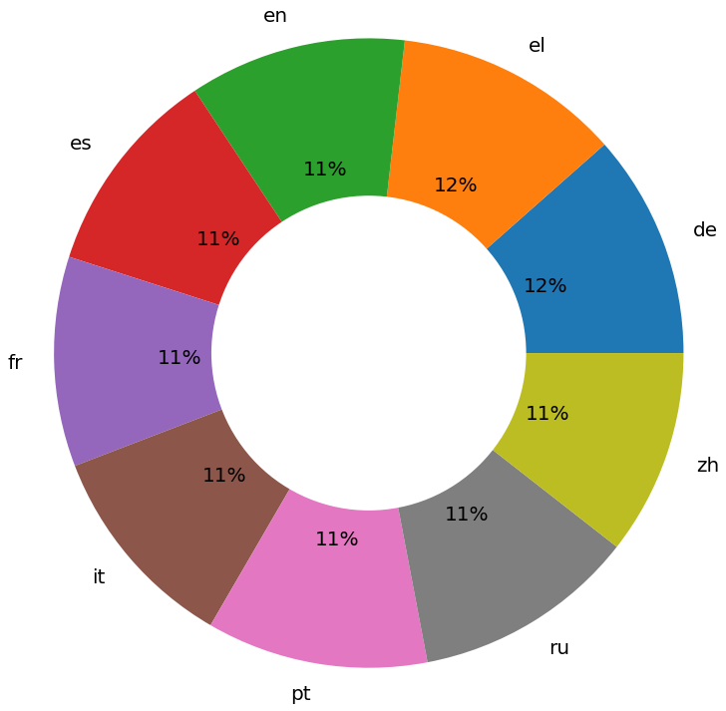
Purchase Power By Ethnicity(Language) & Timings
German
Plot to show the purchase price percentage of ethnic group.
Analysis of Purchase Timings.

Slide 7
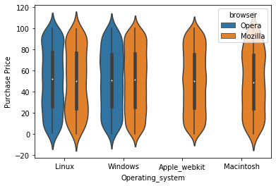
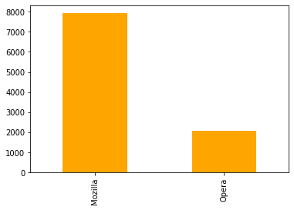
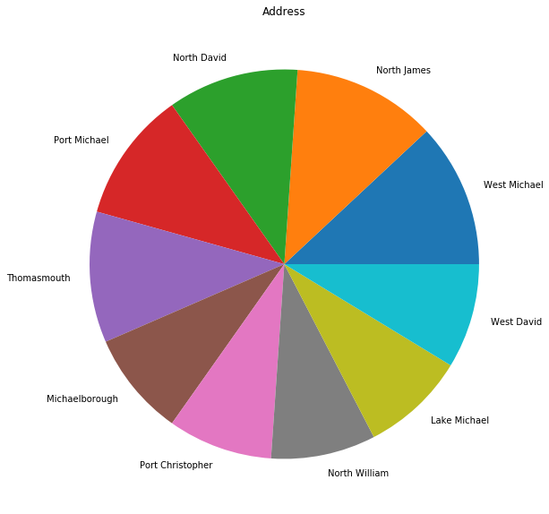
Visualizations of
Browser Usage Analysis
Operating System Analysis
Address Analysis

Slide 8
THANK YOU

